Slide 2
Pentwater Harbor Research Committee
December 2-9, 2013
PentwaterChannel.org

Slide 3
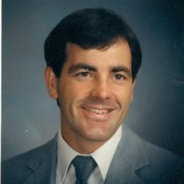
Mark Lee
April 15, 1958-November 25, 2013

Slide 4
Committee formed last year to improve understanding of shoaling of the channel and its outlet
Met 10 times between July 6, 2012 and October 28, 2013
Collegial and productive
Outstanding knowledge and expertise
Excellent help from Prof Guy Meadows, Director of Great Lakes Research Center

Slide 5
Paul Anderson | Chip Gwillim | Joe Primozich
Ed Bigelow | Dan Hoekstra | Milt Pugsley
Bill Bainton | Pat Hooyman | Bill Ribbens
Bruce Birney | Dean Jessup | Kathy Ribbens
Tammy Carey | Dan Kelly | Gordon Rogers
John Carlson | Bruce Koornodyc | Dave Roseman
Lynne Cavazos | John Kran | Barry Rought
Phil Ceton | Amy Labarge | Jean Russell
Jim Chapman | Frode Maaseidvaag | Norm Shotwell
Bob Childers | Mac McCaleb | Chuck Smith
Dan Conley | Christina McVie | Tom Spees
Bob Cornelisen | Jim Miller | Ron Steiner
Ted Cuchna | Andy Noble | Tom Sturr
Mike Flynn | Paul O'Grady | Andy Todd
Marian Garbowski | Tom Osborn | David Webster
John Grant | Denny Powers | Jack Witt
Jared Griffis | Jack Patterson | Larry Zahner
Dean Gustafson | Juanita Pierman

Slide 6
History
Channel dug by Charles Mears in 1850’s
Dredging funded by federal government since about 1876
Dredged nearly every year since 1963
  $3,045,866 in real dollars
  As much as $17,728,700 in inflation-adjusted dollars adjusted to 2011
Channel has shoaled significantly at least twice

Slide 7
"So far as the United States government is concerned, its Pentwater project has been abandoned, and the harbor facilities are being allowed slowly to go ruin. The government engineers have reported adversely to proposals of further development or maintenance and the result is that no more federal appropriations are available for the port. Abandonment, of course, means ruin."[
[local newspaper clipping dated 4-26-21 from Pentwater Historical Society]

Slide 8
Approach
Understand extent of problem
  UnderSee Explorer
  Garmin 441s
  Boston Whaler
  Lowrance sidescan sonar

Slide 9
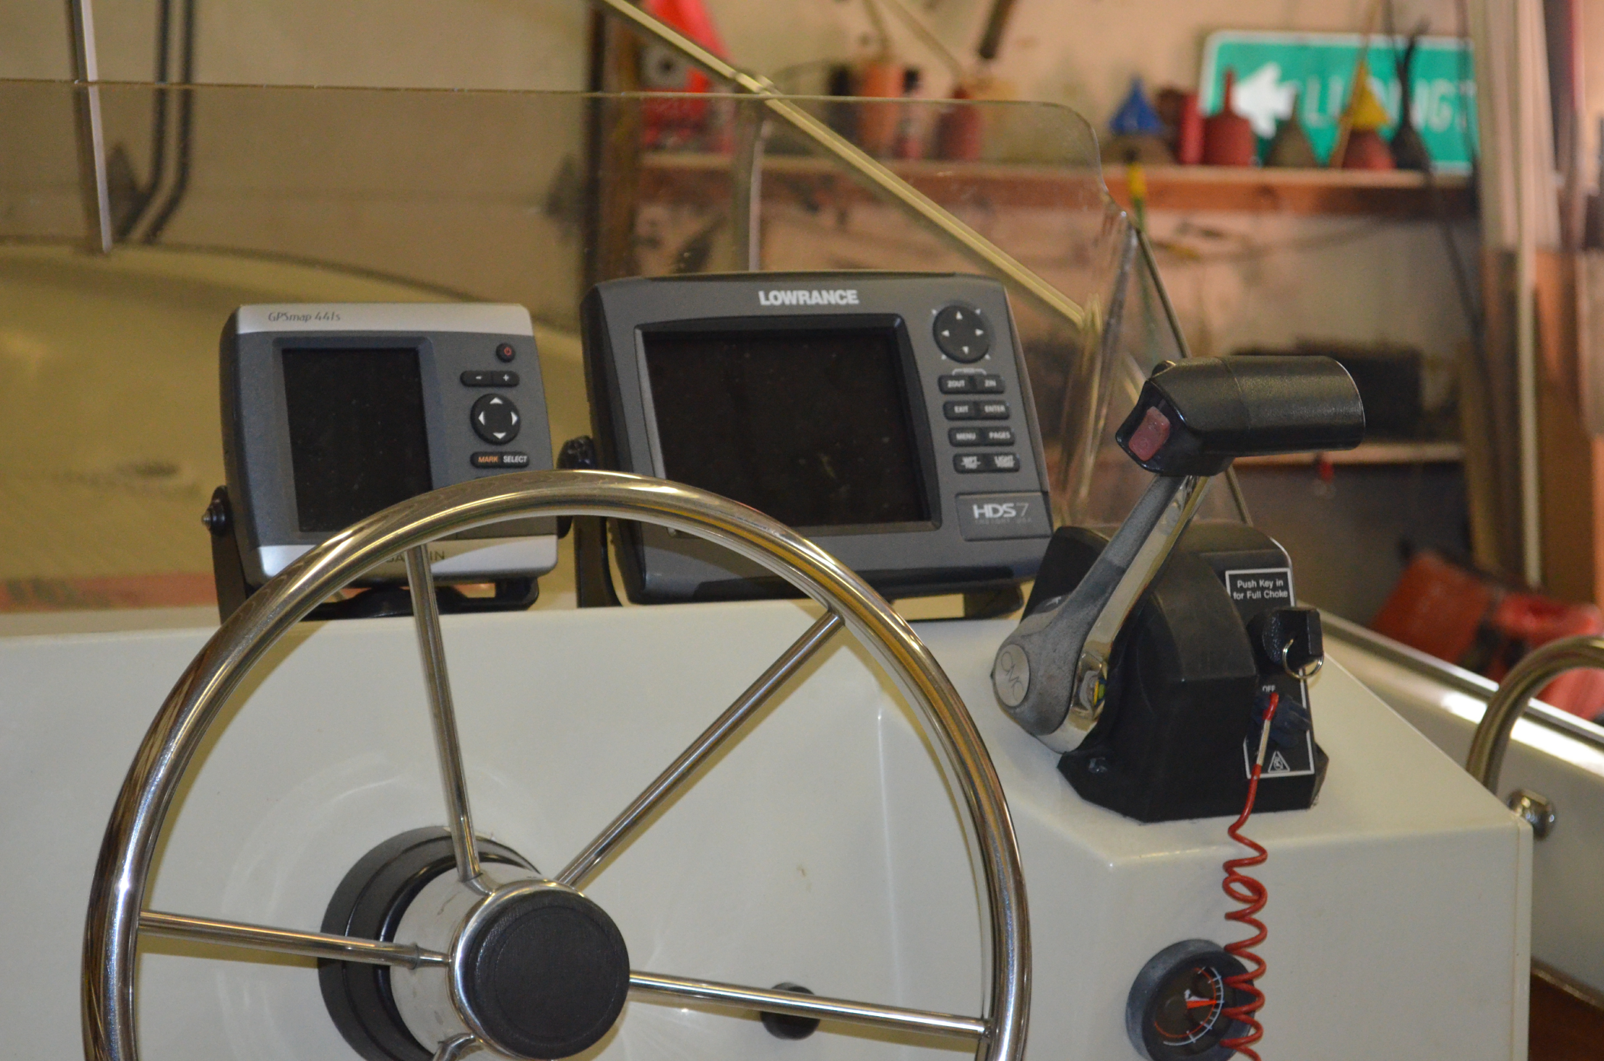

Slide 10
Progress
Mapped about 23 times since March 2012
Worked with software developer William Burlison to add
  Area of interest designation
  Volumes to be dredged
  Animation
Software may become open source, or may have an Software Development Kit or Application Programming Interface

Slide 11
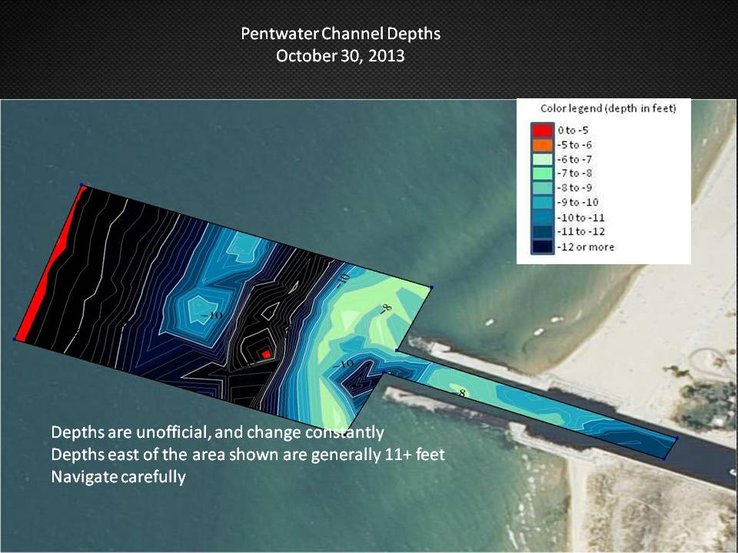

Slide 12
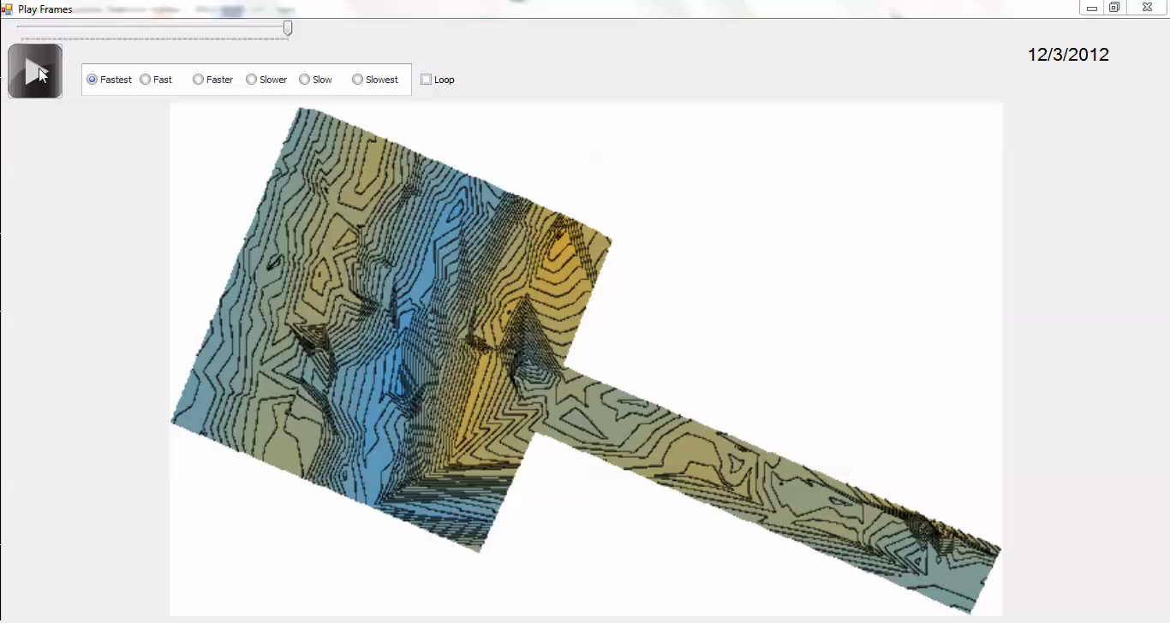

Slide 13
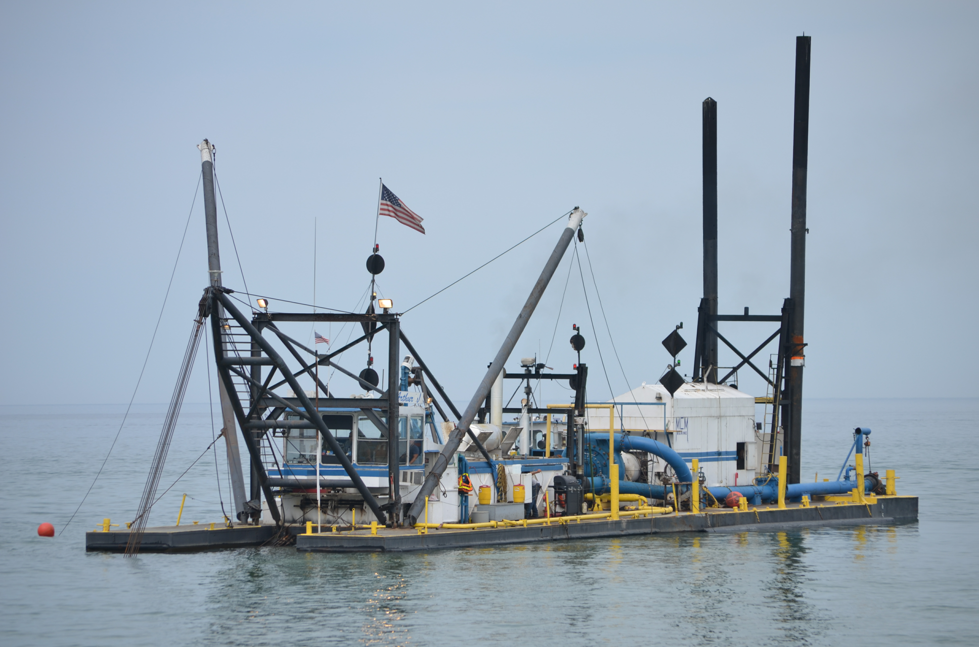
Actions
Oceana County Community Foundation fund
  $45K
Pentwater Village $15K
Pentwater Lake Improvement Board $15K
Dredged July 12-13, 2012

Slide 14
Tentative conclusions
Channel shoaling largely a result of blowing sand
Offshore shoaling caused by wave-driven offshore currents
  Prof Meadows
  USACE

Slide 15
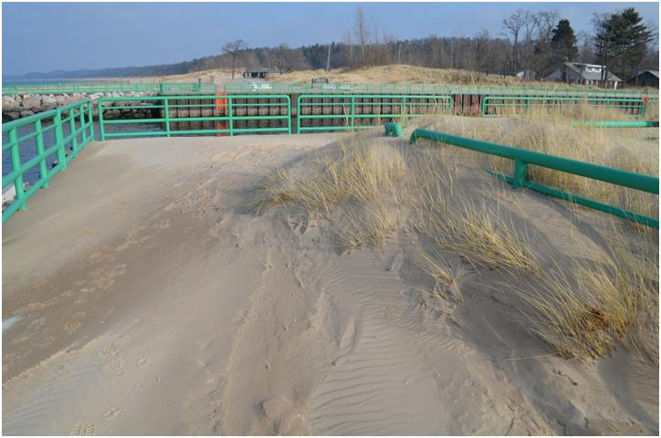
Blowing sand

Slide 16
Spearheaded by Tom Sturr
Great help from Manny Valdez
Fencing installed along north pier railing
  Initially porous
  Impervious layer added
Snow fencing on south side by Oceana Beach Association
  Need permanent fencing

Slide 17
Lake Michigan levels

Slide 18
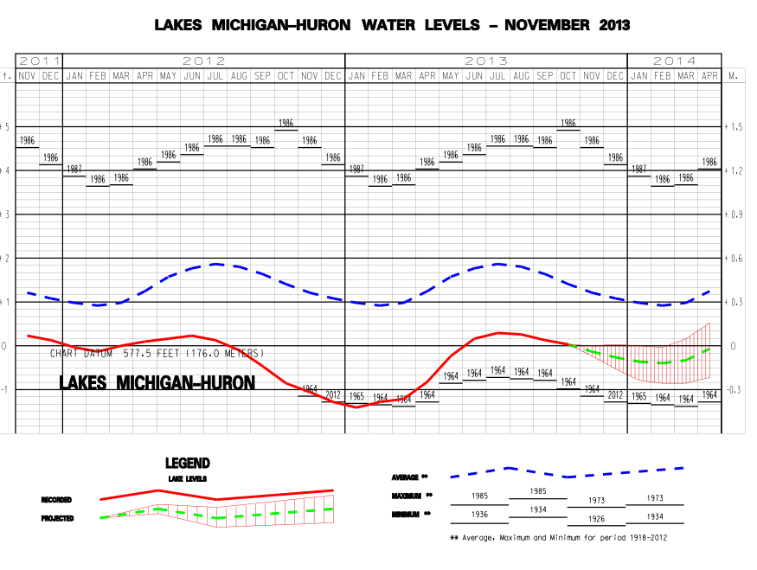

Slide 19
Conclusions
Shoaling will continue to be a problem
Proper fencing will reduce dredging volume
Funding—approximately $50K per year—will be required for the foreseeable future
Funding should be shared by
  Village of Pentwater
  P:entwater Township
  Pentwater Lake Improvement Board
  Private funds under extraordinary conditions
Hope to continue data collection

Slide 21
July 13, 2012

